Slide 1
Team 7
RTG Web Development
Team
Elaine Chen, Riley Brotz, Ryan Yam
Notes:
Script:
Hello everyone, we’re team 7 - the RTG web team. I’m Elaine, this is Ryan, and this is Riley. Our client is RTG, Resonant Technology Group, and we’re helping this company to build their website.

Slide 2




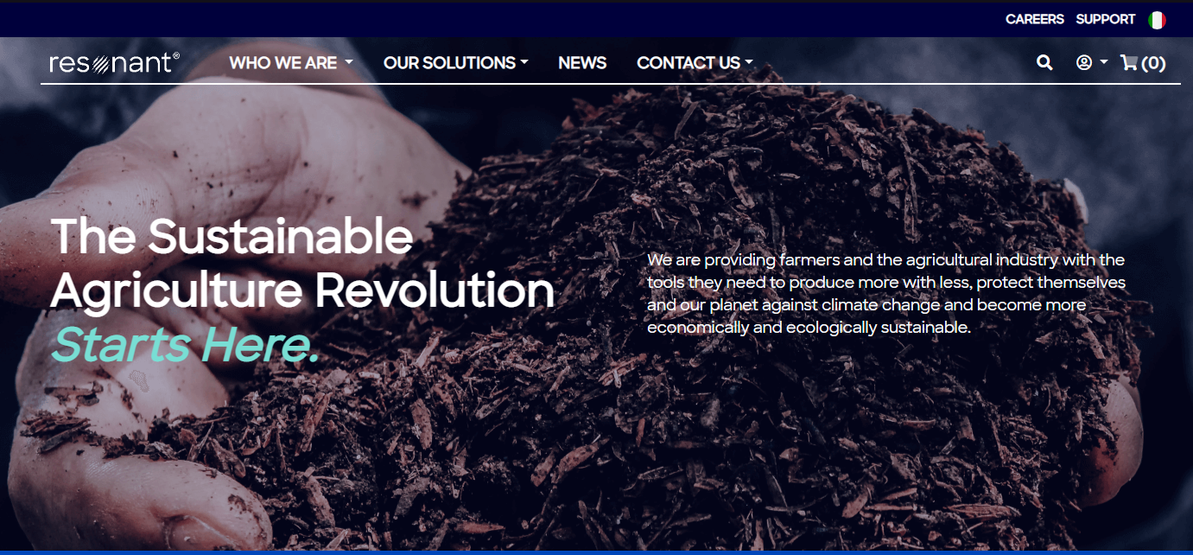
Who is Resonant Technology Group?
Agricultural Additives
Notes:
Script:
Here’s some context about RTG. On the far left, this is RTG’s parent company called the SOP farm. And SOP stands for save our planet. It’s a certified and sustainable benefit company based in Milan, Italy. They do a lot of research and develop advanced agricultural products that promote sustainable agriculture. And it’s been very successful in Europe for a long time.
RTG was formed in early 2023. Their goal is to adopt the advanced agricultural products that have been developed and sold by SOP farm into the US dairy market.
RTG wants to display information in a simple way, increase the believability of the products and the ability to have minor sales portal, but the current website is not good enough to serve these purposes.
2 main themes/purposes: education & believability. SOP products →RTG in website for US market →US Dairy Market (first product focus)

Slide 3




RTG Website - The Problem
Information Display
Navigation System
Sales Portal
Website Editor
Notes:
Script:
So, RTG already had an existing website, but there are some problems with the current website that need to be fixed.
First of all, how all the information was laid out on the website didn’t guide the user’s attention very well to where they want the user to look at, and sometimes quite confusing, which made it hard to educate the users who wish to learn more about RTG and convince them of the believability of the company.
This is a major problem because what information you’re showing and how you organize and display them on a page can really affect a user’s impression on the website.
Secondly, the navigation system of the current website is also not the most intuitive, which will make the user easily feel lost when they’re browsing the website and hard to find what they want from the website, either for more information of a product or making a purchase.
Talking about the purchase, the sales portal of the current website is also very confusing, making it really difficult to make a purchase, which I’ll show you in a bit.
Lastly is the website editor, the tool they were using to build the current website is BigCommerce. It’s very hard to use and we found it very hard to even figure out how to add another item in the nav bar.
RTG wants to display information in a simple way, increase the believability of the products and the ability to have minor sales portal, but the current website is not good enough to serve these purposes.
2 main themes/purposes: education & believability.

Slide 4
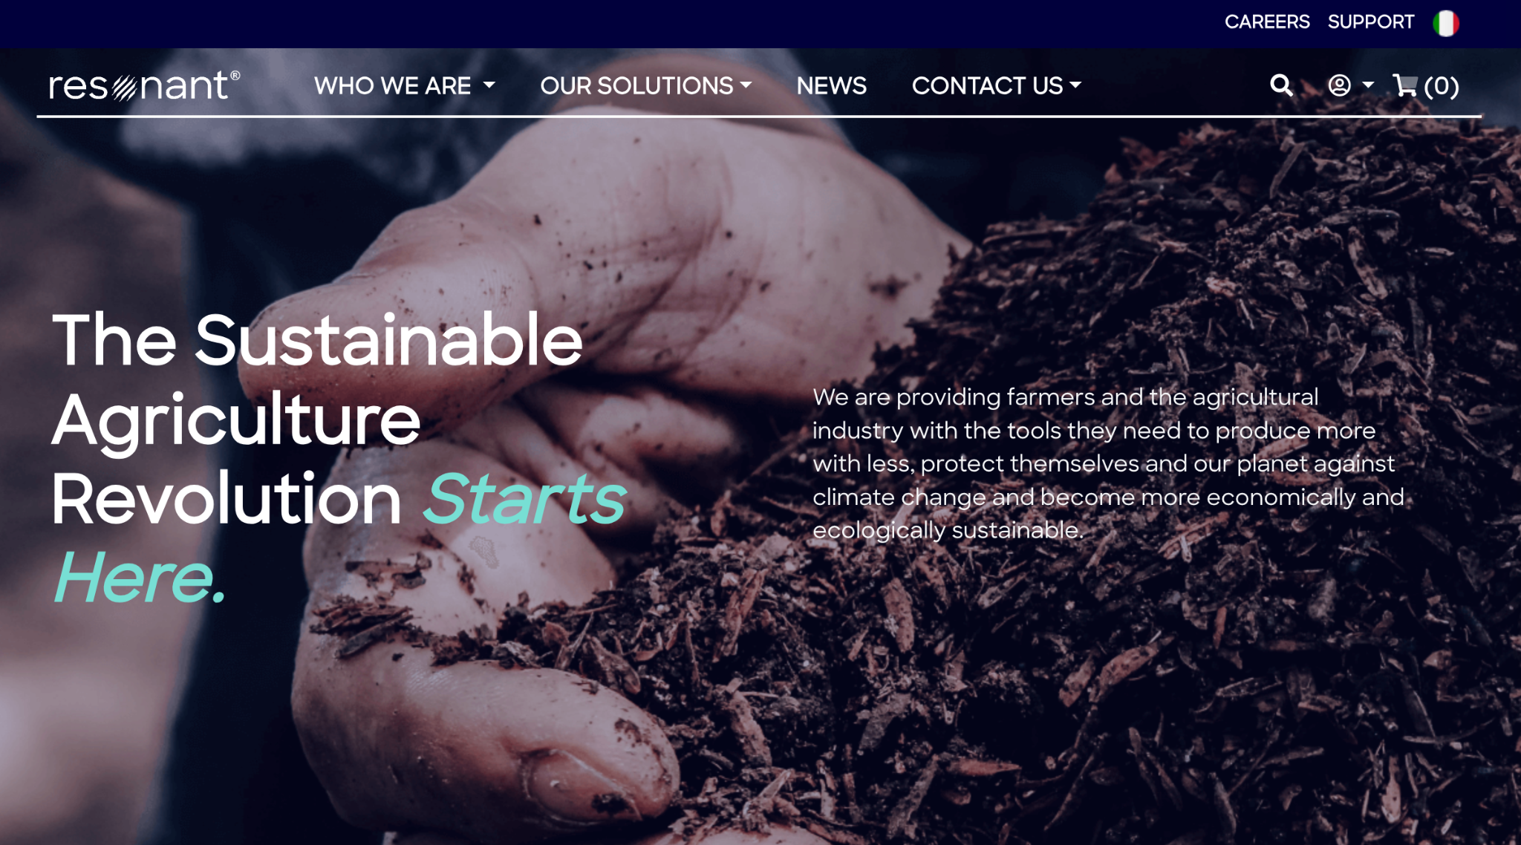
Screenshot from Current Website
Notes:
Script:
So, Here I’ll explain the problem they’re having with the current sales portal.
Here we’re on the homepage of the website. As you can see, if you wanna purchase something, you might click on the shopping cart icon at the top right corner.

Slide 5
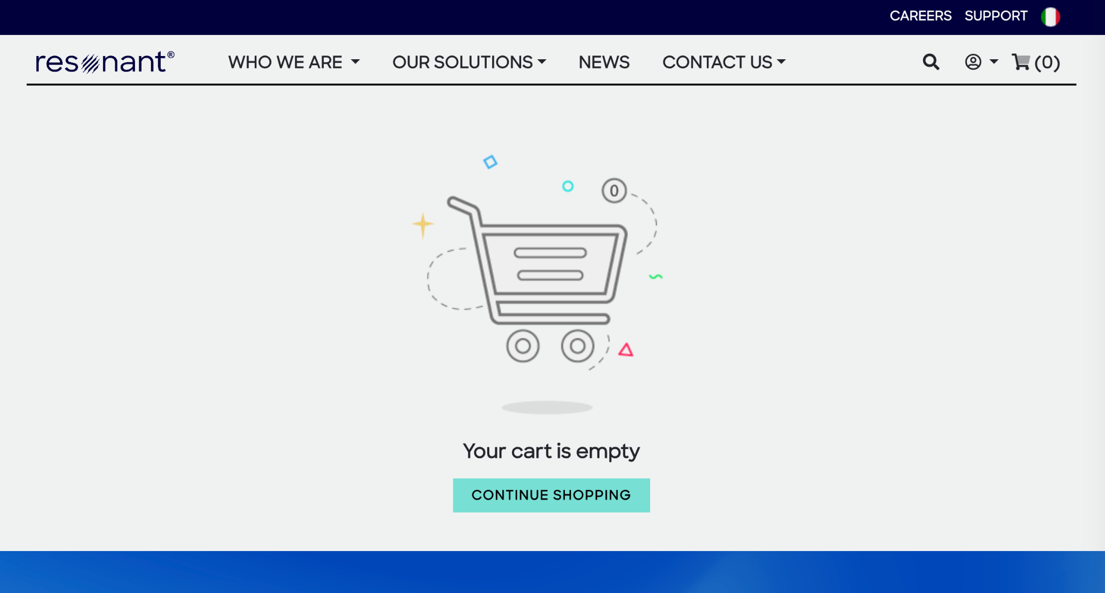
Screenshot from Current Website
Notes:
Script:
You are brought to this page saying your cart is empty, which makes sense since we didn’t add anything yet right. So, we’ll click Continue Shopping.

Slide 6
Screenshot from Current Website
😳
Notes:
Script:
Surprise, we are brought back to the home page again. You might think what’s going on right now? And think, where are all the products listed? And you see this nav bar item called Our Solutions - that’s probably where you should go.

Slide 7
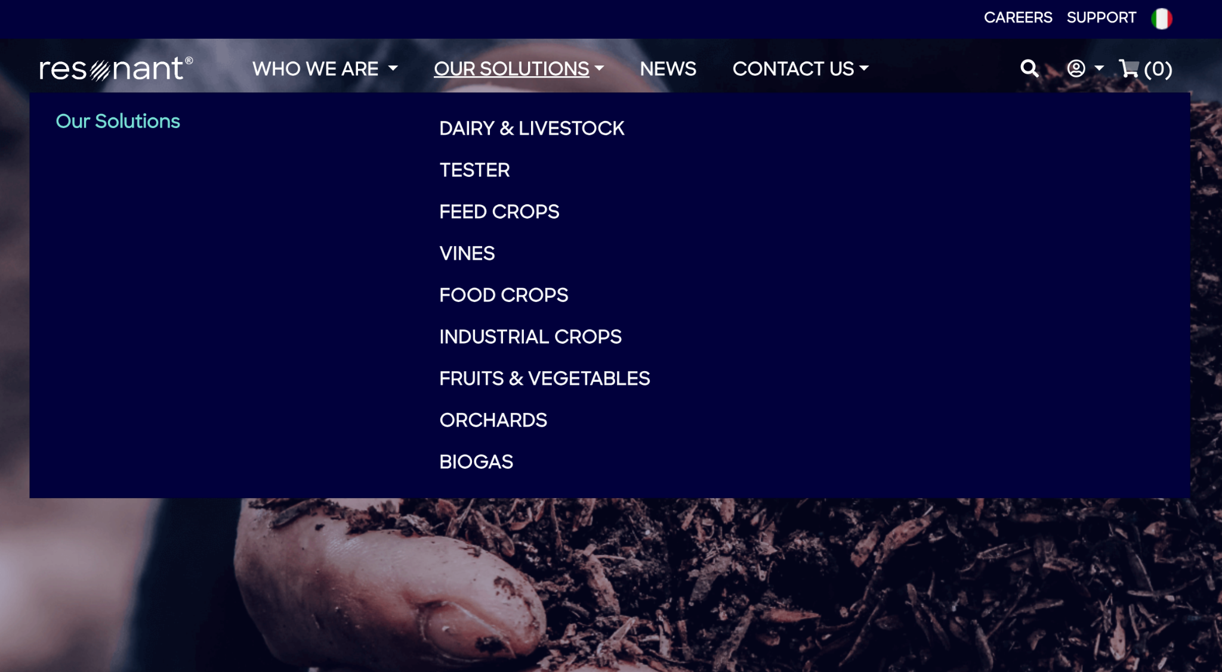
Screenshot from Current Website
Notes:
Script:
So, you hover over it, and see a list of categories of their products. You click on one of them called dairy and livestock.

Slide 8
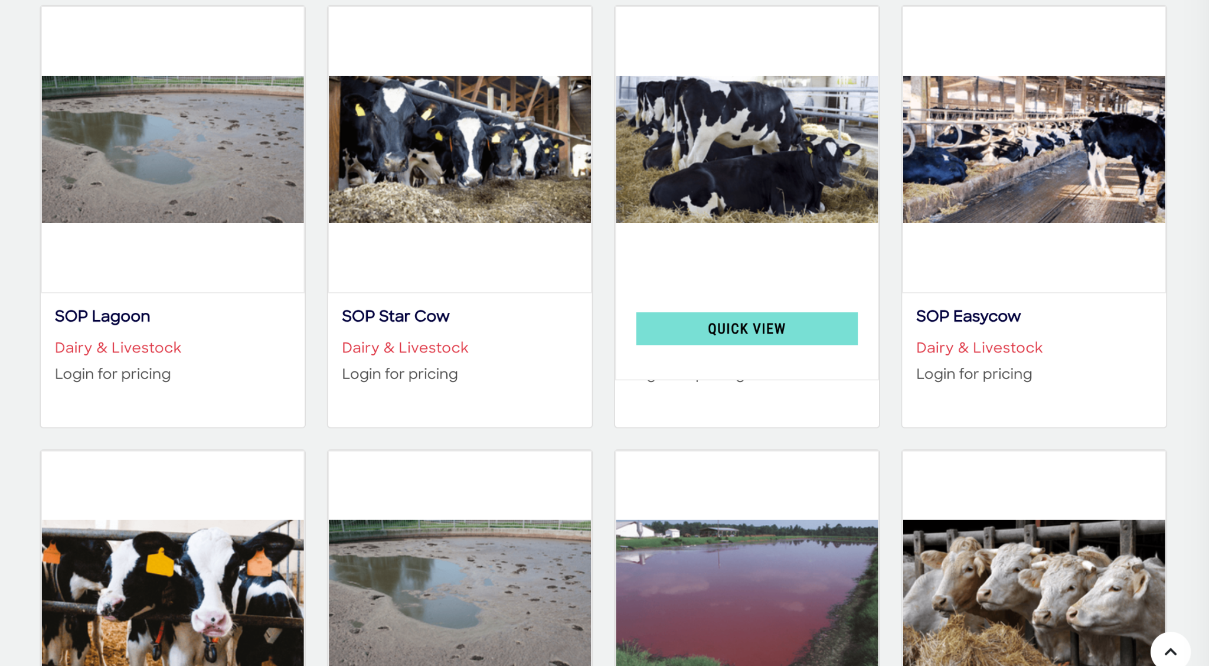
Screenshot from Current Website
✨
👀
Notes:
Script:
Yay you see the products now~ Even though there’s only a picture and a name displayed for each product. If you hover over a product, you see there’s a quick view button. And you might think that’ll probably give you more info.

Slide 9
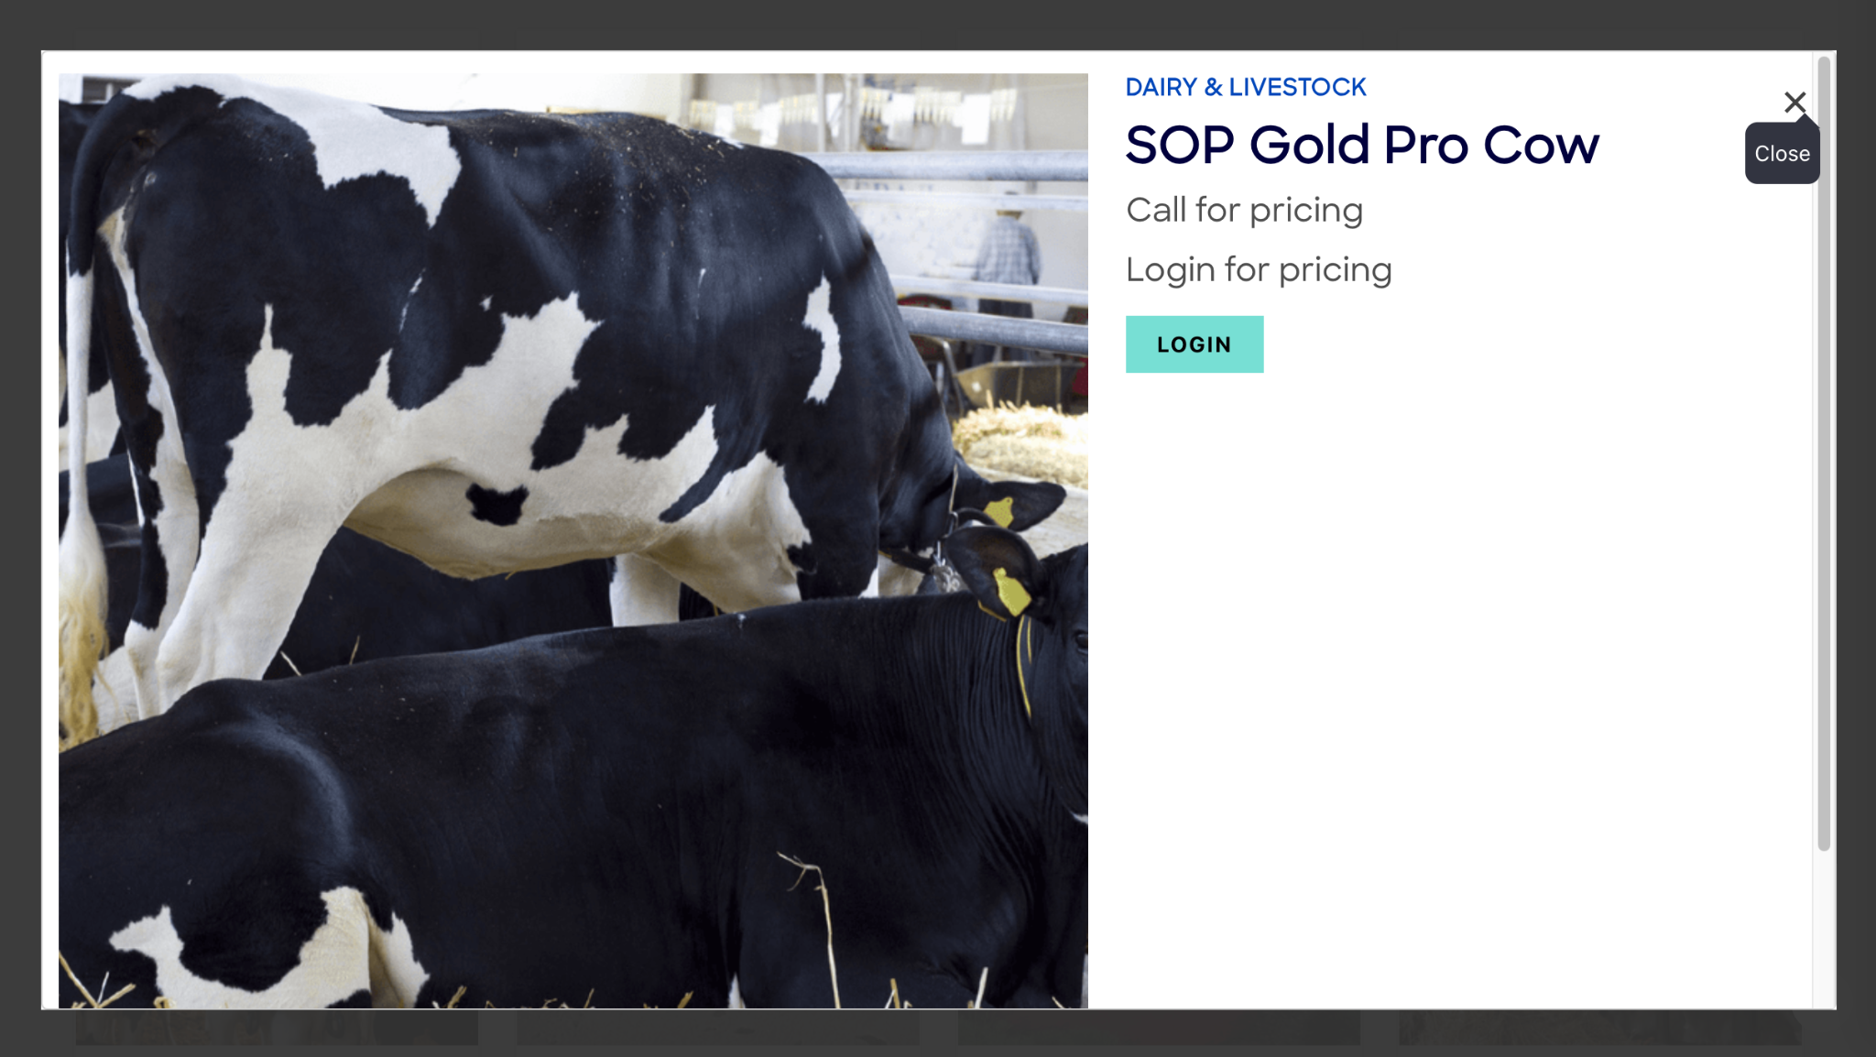
Screenshot from Current Website
😫
Notes:
Script:
You get a zoomed in version of the same picture and nothing more except for a Login button cuz you’ll need to login for pricing.
So, it’s a lot of work already for the user so far, but they still didn’t learn anything about RTG’s products. 😫

Slide 10
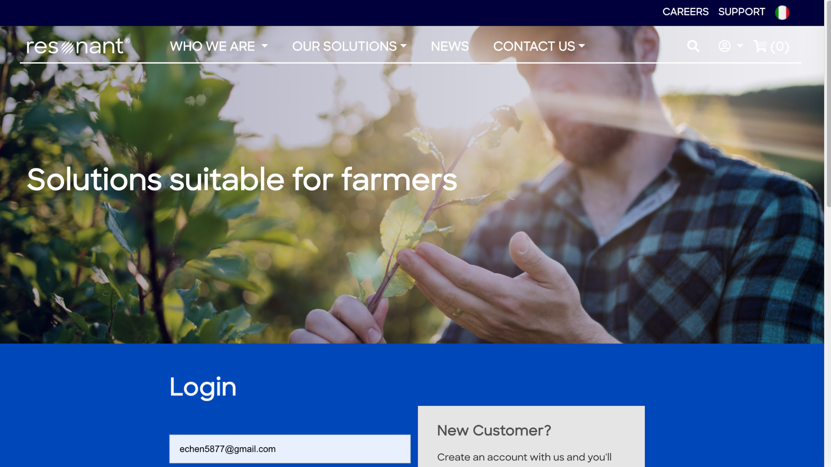
Screenshot from Current Website
👀
Notes:
Script:
Next, if you click login, you’ll be brought to the solutions page that prompts you to create an account if you don’t have one.

Slide 11
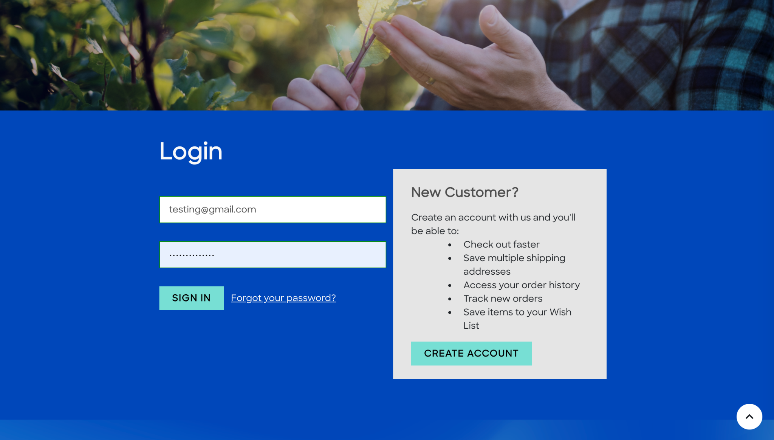
Screenshot from Current Website
🚶I give up…
Notes:
Script:
At this point, the user will probably just give up and walk away. 🚶

Slide 12


Screenshot from Home Page
Not Catchy Enough
Notes:
Script:
Here’s another example from the current home page. As you can see, there’s big paragraph with texts that are rather small, so the user will likely just ignore this whole paragraph and keep scrolling down when they land on the website. So, there’s definitely room for improvement on the design of the landing page too.

Slide 13




Our Solution
Revamp the company website:
Improved Formatting for Clarity
Redesigned User Journey
Revitalized Sales Portal
Adoption of Simpler Website Editor
Notes:
Script:
Our solution to all these problems is to revamp the company website.
We’ll be focusing on redesigning the website layout (and the navigation system) to improve the clarity of the information displayed making them easier to digest. And also redesign the navigation system to make it more intuitive for the user when they’re browsing the website. We’ll also revitalize the sales portal to not only make it easy to use, but also make it more attractive to the users to make a purchase.
Finally, we’ll be migrating to another website editor called Wix, which is much easier to use than BigCommerce. This way, RTG will be able to modify the website on their own too.
RTG wants to display information in a simple way, increase the believability of the products and the ability to have minor sales portal, but the current website is not good enough to serve these purposes.
2 main themes/purposes: education & believability.

Slide 14
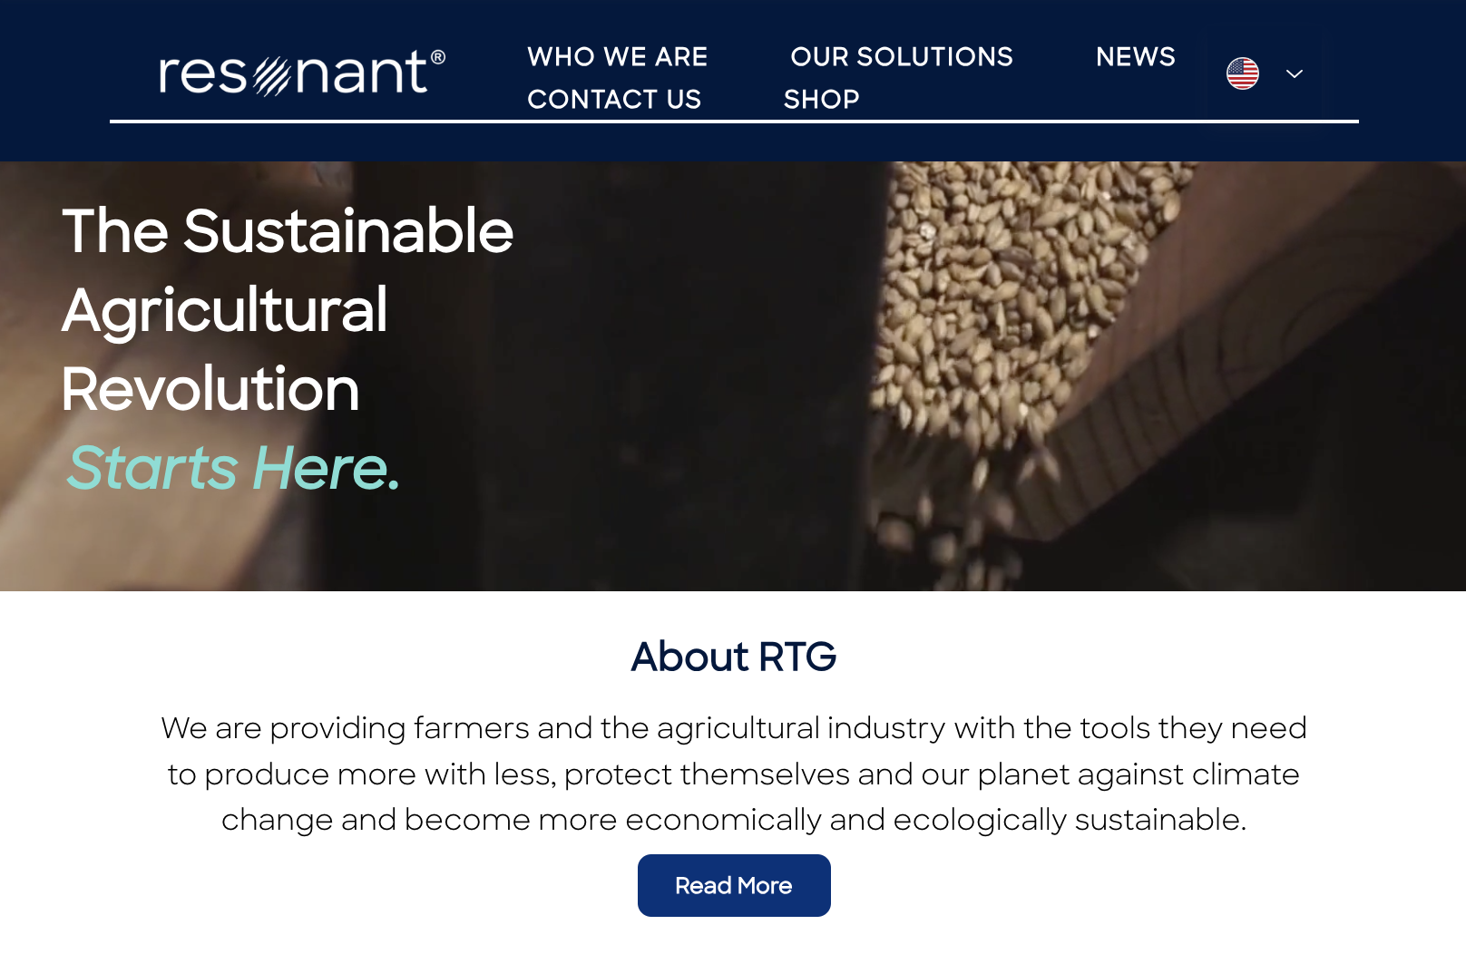
Our Solution
Notes:
Script:
Here’s an example of how we’ll revamp the home page. This is the old version. And for the new version, we’ll be adding a video background behind the tagline, and move the overview paragraph to a new section down below and name it About RTG, and also provide a Read More button. This way, it looks clearer and the user will more likely to read it.

Slide 15
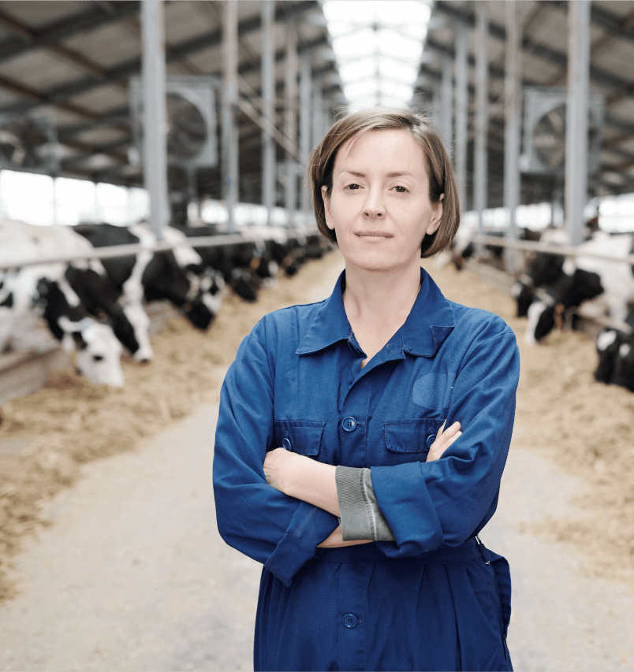
The Customer: NY Dairy Farmers
3,800 farms, 630,000 cows
50-65 year old
Majority male
Not tech-savvy
Younger successors
30-45 year old
Is tech-savvy
Notes:
Script:
You might be wondering, who are the customers? The answer is New York Dairy Farmers. The primary customer persona of these farmers are 50-65 years old with a male majority and are not as tech savvy. Another prominent type of dairy farmer are the successors of these farmers, who tend to fall between 30 and 45 years old and are more tech savvy by comparison.
TAM: The top five dairy states have 5,000,000 cows; New York being 5th with 630,000 cows on 3,800 farms.
Notes:
Important to mention that the stats are used to illustrate that these dairy farmers are busy and need a quick way to learn about RTG “to make the point that these are large operations, busy customers – need to find information and order product quickly and efficiently” ~Sue.
$2,791,507,592 in Gross Farm Income from Milk
109 Dairy Plants in Total
Refer back to the personas given by Josey

Slide 16

Market Size
$2 Trillion
276,000 North American dairy farms
TAM:
$54 Million
6,000 North American dairy farms with greater than 1,000 cows
SAM:
$54,000
60 New York(Central NY, Finger Lakes, Southern Tier) dairy farms with greater than 1,000 cows
S0M:
Notes:
Script:
So the total available market is $2 trillion from North American dairy farms, the serviceable available market is $54 million dollars from North American dairy farms with more than 1,000 cows, and the serviceable obtainable market is $54,000 dollars from New York dairy farms with more than 1,000 cows.
Tam is not limited by region.
For each of them, dollars of farm, cow number
TAM: $2 Trillion 276,000 North American dairy farms
SAM: $54 Million 6,000 North American dairy farms with greater than 1,000 cows
SOM: $540,00060 NY dairy farms with greater than 1,000 cows
Calculation for Market Size Dollars Estimate Number of boxes needed for 1st year: 4(Activation) + 26(6 months) + 26(6 months) = 56 boxes Cost of boxes for 1st year: 56 boxes * $161.00 = $9,016 TAM: 276,000 farms * $9,016 = $2,489,616,000
SAM: 6,000 farms * $9,016 = 54,096,000
SOM: 60 farms * $9,016 = $540,960

Slide 17
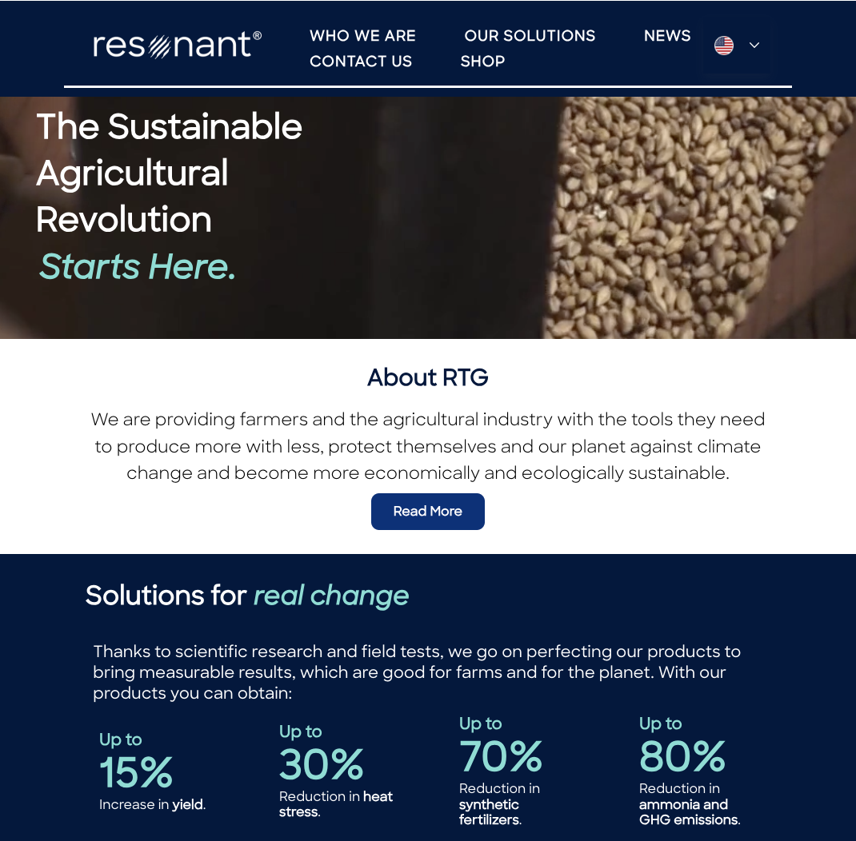
Our Product
Revamped RTG Website:
Redesign the user journey to improve the user experience
Implement new features desired by RTG
Notes:
Script:
Our product is a revamp of the RTG website. We have redesigned the user journey to improve user experience and implemented new features recommended by RTG. Now let’s take a look at some pages from this site.
Notes:
Explain in high level if there’re many words on the slide.
Only show what u want the user to look at.
When there’s a lot of words, user will likely just read them.

Slide 18



Value Proposition
For dairy farmers who want to learn more about RTG, our cost effective revamp of the website provides a simple and efficient user experience while increasing the believability of RTG and its products, as opposed to learning about RTG via word of mouth.
Notes:
Script:
Our value proposition is … (read word for word value proposition)

Slide 19
The Competition
 | RTG | Mootral | ProAgni
Simplicity | ✅ | ❌ | ❌
Efficiency | ✅ | ✅ | ❌
User Friendly Navigation | ✅ | ✅ | ❌
Farmer Testimonials | ✅ | ❌ | ❌
Certifications | ✅ | ✅ | ✅
Notes:
Script:
While revamping the website, we took a closer look at some of RTG’s competitors, such as Mootral and ProAgni. Every site has certifications. The RTG site after its revamp is simple, efficient, user friendly, and has farmer testimonials. Mootral’s website only offers half of these benefits and Progani’s website offers none of these.

Slide 20
Business Model
Marketing and Credibility
SOP Products
Promotes
SOP Products
Partnership
Distributors
Notes:
RTG uses the Website for Marketing and Credibility
This allows them to sell SOP Products to dairy farmers
In addition RTG will also partner w/ Distributors
Who will promote the website and also sell SOP Products to dairy farmers
Basically just explain the graphic

Slide 21







Marketing/Sales Plan
360 Marketing Plan
Owned
Paid
Earned
Shared & Managed
Blog Promotion
Online Ads
Online Relations
Social Media
Notes:
This is the marketing plan from RTG
Called the 360 marketing plan
It consists of 4 main channels… The website will go into the owned channel where
The focus will be on a blog within the website and they will have a newsletter to promote it
The other channels will focus on generating marketing through RTG’s online presence
Through online ads, paid influencers, and social media

Slide 22
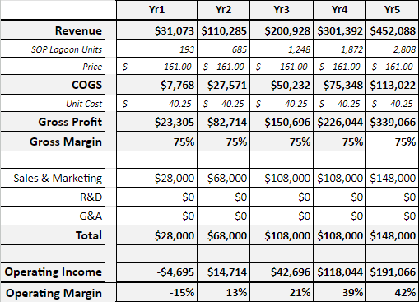
Financial Projections
Notes:
This is a 5 year incremental plan for RTG
It is for SOP Lagoon which is one of RTG’s main products For clarity the Units represent boxes of SOP Lagoon
Some of the assumptions that we made were for
Unit Cost which we assumed is 25% of the Price
Sales & Mark… covers the salary of Sales Representatives
R&D 0 b/c SOP Farm does research
G&A 0 b/c company won't grow drastically

Slide 23


Management Team
Ian Hoffman
Josey Cheah
VP Technology Development
Chief Marketing Officer
Notes:
Ian and Josey, SOP marketing team (management of the website redesign) No need to read titles
Talk about what they did
Ian - General Direction/Information about RTG
Josey - More Technical and detailed information on the website. Also worked alongside us on the site.

Slide 24




Learning Plan
User Testing
Sales Portal Development and Testing
Customer Discovery
Website Relaunch
Notes:
No “we” only recommendations for RTG Go through each item left to right
Customer Discovery to identify what content needs to be on the site
And fine tune features on the site

Slide 25
Handoffs
Business Pitch Deck
BigCommerce Documentation
Debugging & Suggestions for Wix Website
Competitor Website Observations
Customer Discovery Findings
User Testing Document
Notes:
These are our handoffs to the company
Just a couple of documents that we think would help RTG
No need to go through 1 by 1

Slide 26
Thank you! :)
Notes:
Tyty <3.

